Slide 1

Early Detection of Diabetes Using Machine Learning
Team
Model Mavericks
Outline
Introduction
Exploratory Data Analysis (EDA)
Data Preprocessing for Model Building
Model Building and Evaluation
Conclusion

Slide 2
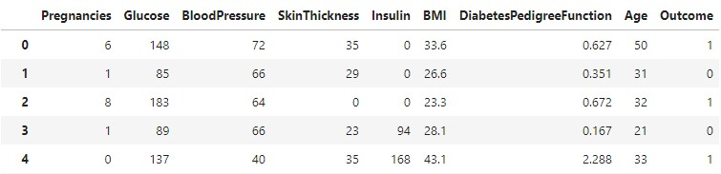
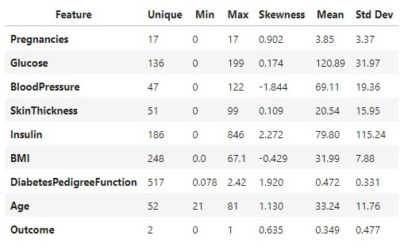
1. Introduction
1.1. Background
This presentation outlines a data science project focused on building a classification model to predict diabetes based on various health indicators. The goal is to assist mobile health clinics in pre-screening patients to identify individuals at risk and reduce hospital crowding.
1.2. Problem Statement
Background: A mobile health clinic aims to improve patient pre-screening for diabetes using basic health indicators.
Objective:
Conduct Exploratory Data Analysis (EDA) to uncover factors influencing diabetes risk.
Develop a classification model to predict diabetes based on attributes like BMI, glucose, insulin levels, and age.
1.3. Data Overview
Dataset Size: 768 entries (rows) and 9 features (columns).
Features: Pregnancies, Glucose, BloodPressure, SkinThickness, Insulin, BMI, DiabetesPedigreeFunction, Age, Outcome (target variable: 0 for No Diabetes, 1 for Diabetes).
Fig 1. Data Preview & Summary

Slide 3
2. Exploratory Data Analysis (EDA)
2.1.1. Initial Data Quality Checks: No missing values and No duplicate rows
2.1.2. Statistical Summary Highlights:
Glucose, BloodPressure, SkinThickness, Insulin, and BMI had a minimum value of 0, which are biologically implausible and indicate potential missing/imputed values needing preprocessing.
Insulin and DiabetesPedigreeFunction showed high positive skewness, suggesting non-normal distributions.
2.2.1 Univariate Analysis
Outcome Distribution: The dataset showed an imbalance, with approximately twice as many "No Diabetes" cases (0) as "Diabetes" cases (1).
Pregnancies Distribution: Most individuals had 1 pregnancy, followed by 0. Higher numbers of pregnancies were less frequent.
Distribution of Numerical Features (KDE Plots):
Glucose, Insulin, BMI, DiabetesPedigreeFunction, and Age exhibited varying degrees of skewness; particularly Insulin and DiabetesPedigreeFunction were highly right-skewed.
2.2.2 Multivariate Analysis
Correlation Matrix Insights:
Outcome & Glucose (0.47): A moderate positive correlation, indicating higher glucose levels are associated with a higher likelihood of diabetes.
Pregnancies & Age (0.54): Moderately positive, suggesting older individuals tend to have more pregnancies.
Outcome & BMI (0.29): A weak positive correlation. •
SkinThickness & Insulin (0.44): Moderate positive correlation.

Slide 4
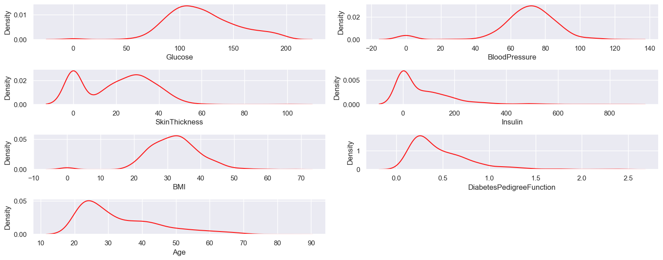
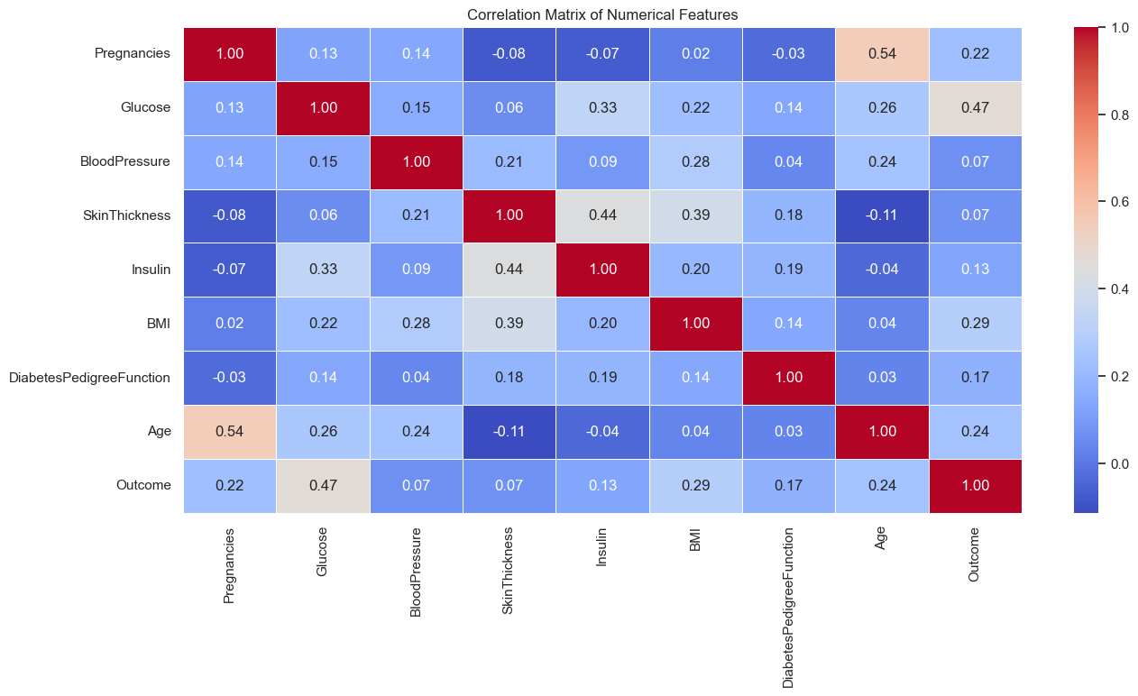
Fig 2. Distribution of Numerical Features (KDE Plots) Fig 3. Correlation Matrix

Slide 5
2. Exploratory Data Analysis (EDA)
Pairwise Plots (Colored by Outcome):
Visually confirmed Glucose as a strong differentiator between diabetic and non-diabetic individuals, with diabetics clustering at higher glucose values.
Age vs. BMI and Age vs. Glucose plots showed that older individuals with higher BMI or glucose levels were more likely to be diabetic. •
Insulin and SkinThickness showed wide variability without clear separation by outcome.
2.2.3. Multivariate Analysis
Box Plots (Features by Outcome):
Glucose levels were significantly higher for individuals with diabetes.
BMI showed a slight upward trend for diabetics. • Age indicated that diabetics tend to be older.
BloodPressure showed overlap, suggesting less distinction by outcome.
2.2.4. Feature Engineering
BMI Category: A new feature BMICategory was created (Underweight, Normal, Overweight, Obese).
Insights from BMI Category:
Obese and Overweight individuals tended to have a higher average number of pregnancies.
Individuals with diabetes (Outcome = 1) consistently showed higher glucose levels across all BMI categories (Obese, Overweight, Normal, Underweight), reinforcing the importance of glucose.
General EDA Insight: Glucose levels are the most influential factor impacting diabetes risk, followed by BMI and Age. Other features showed weaker direct relationships.

Slide 6
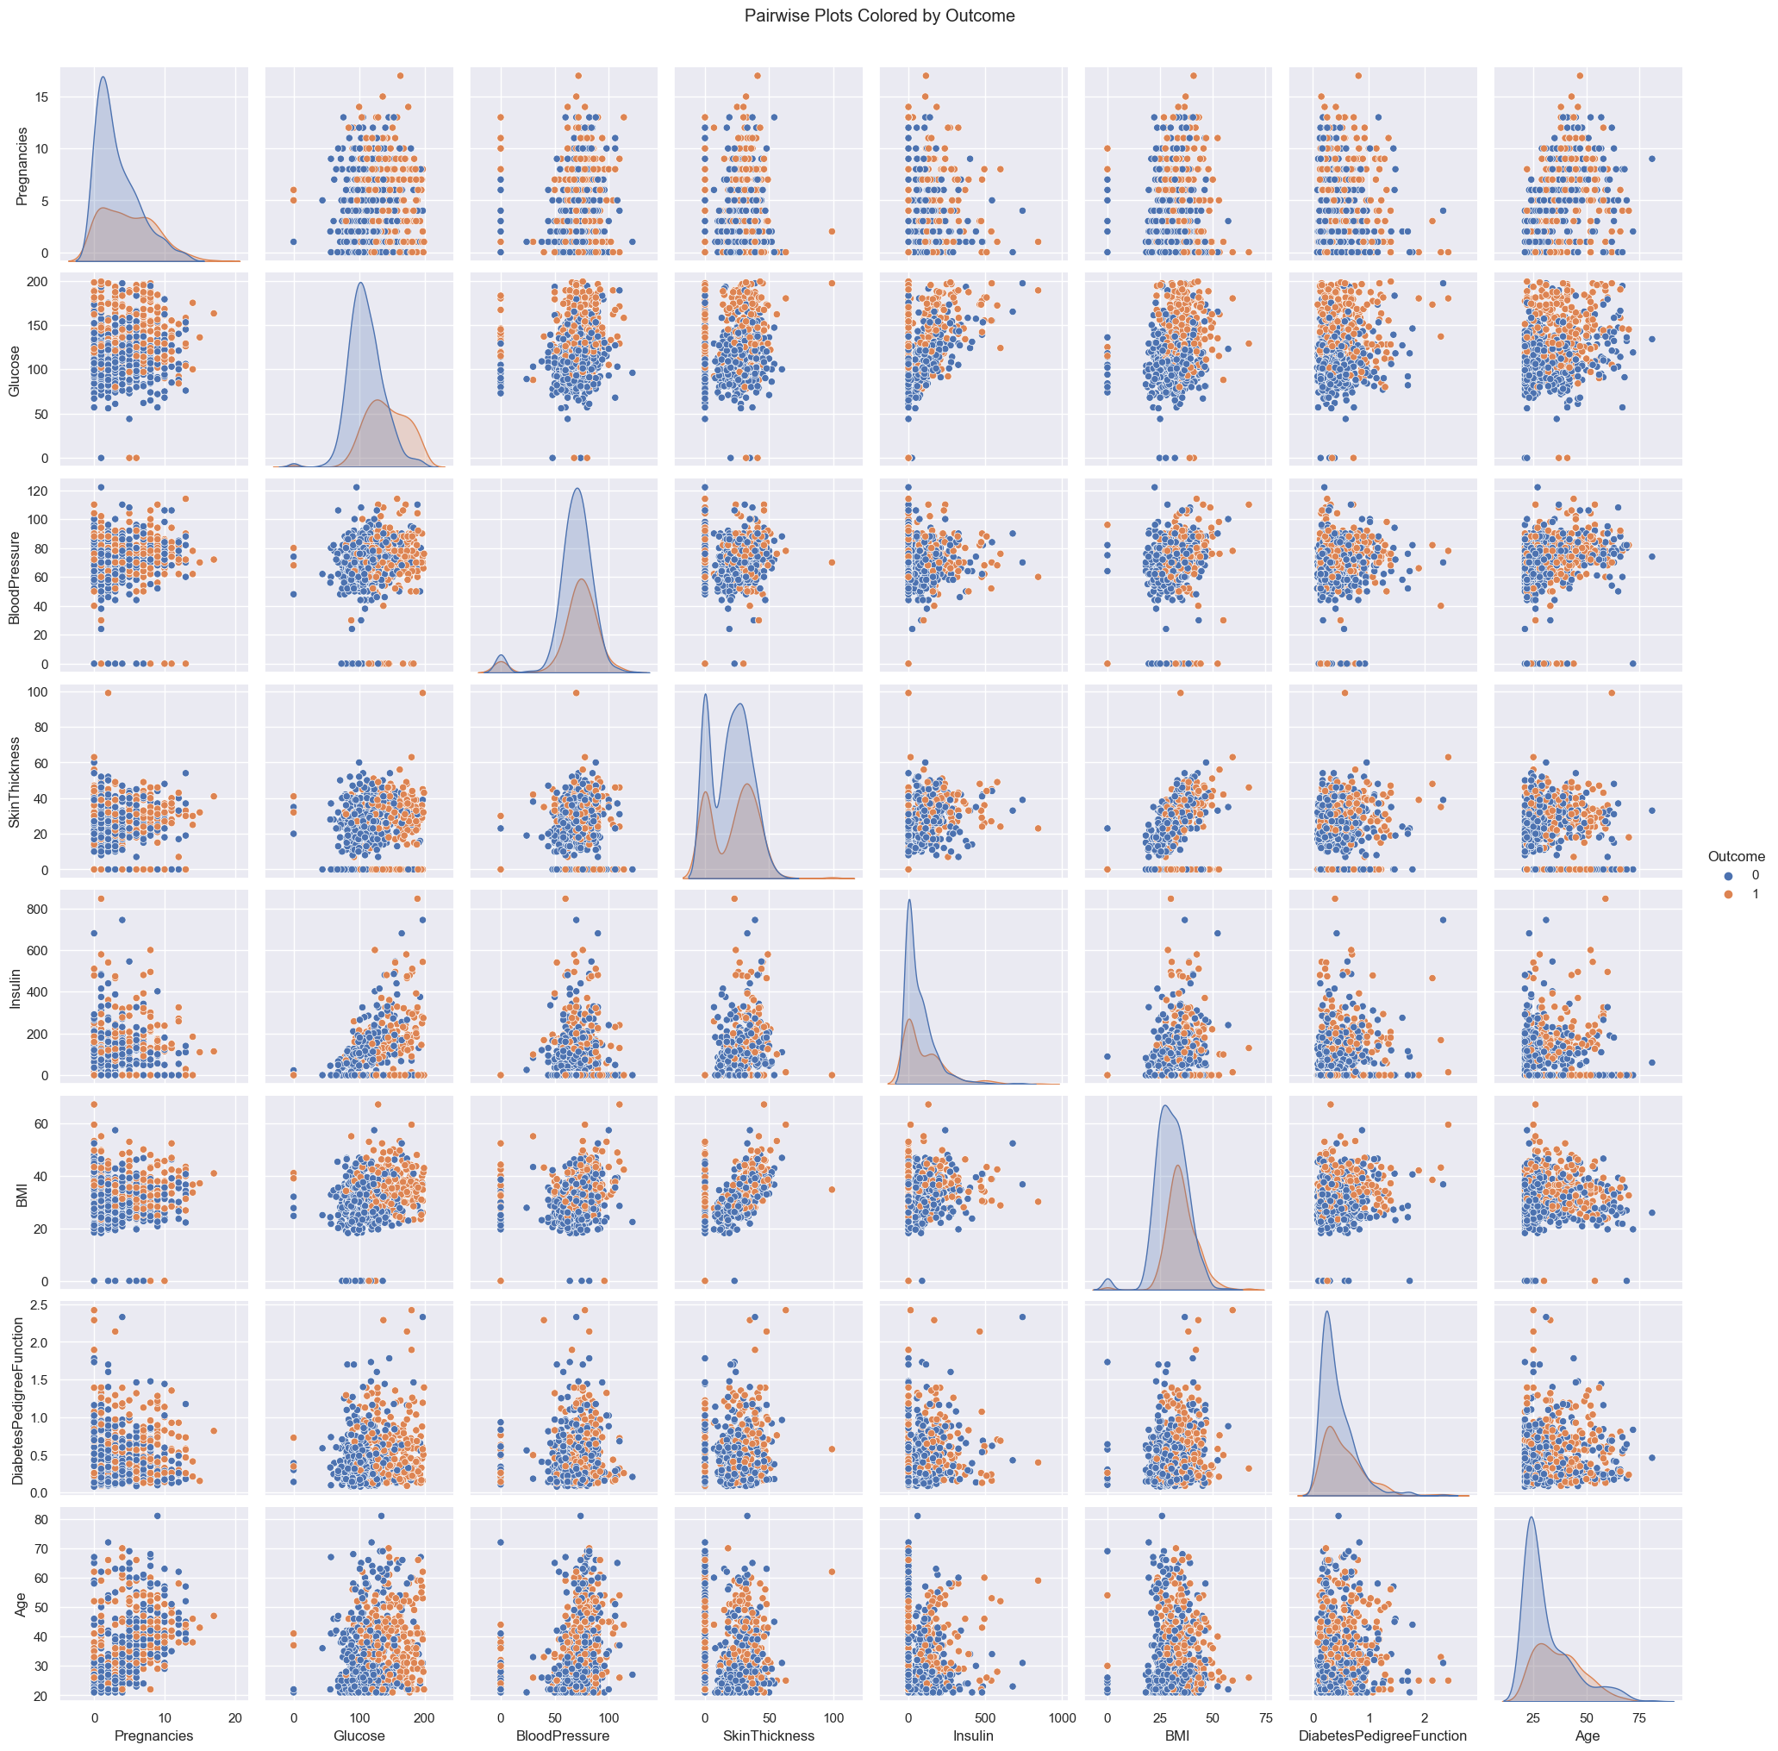
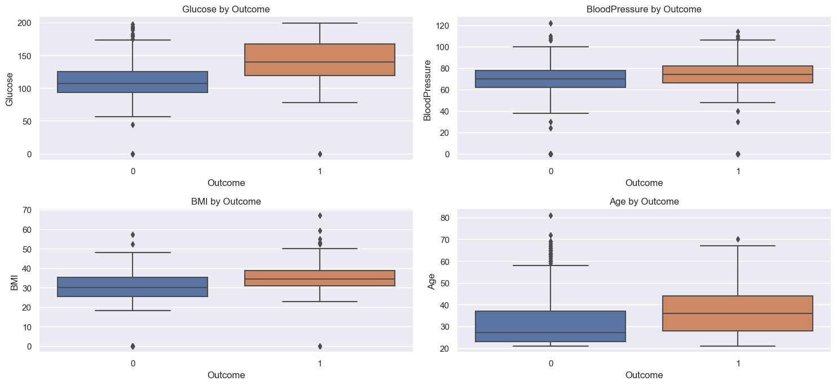
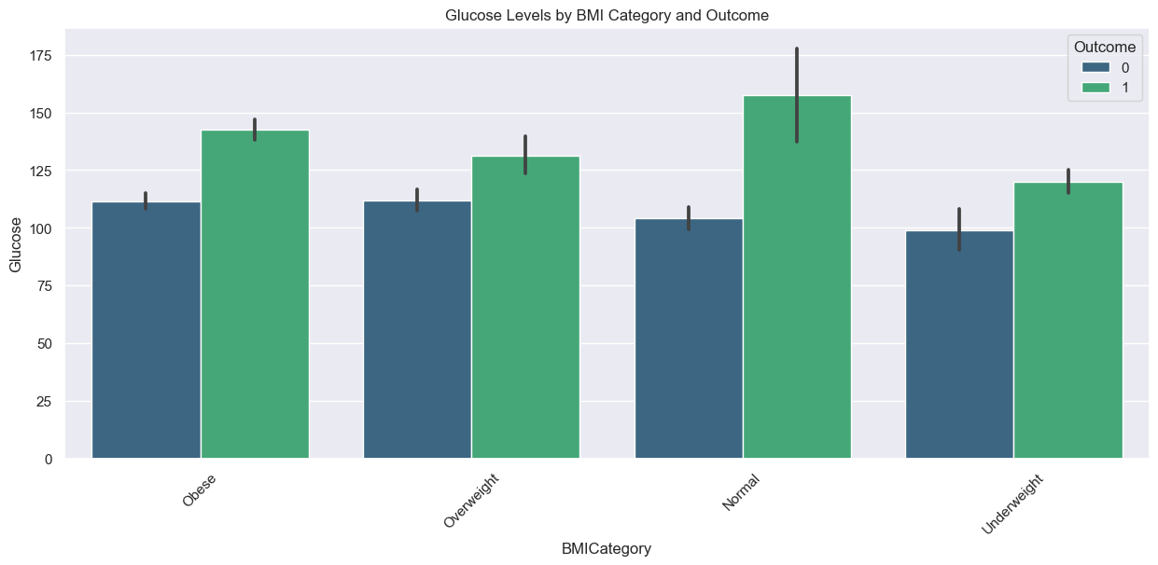
Fig 4. Features Pairwise Plots Fig 5 & 6. Insights from Outcome & BMI Category

Slide 7
3. Data Preprocessing for Model Building
3.1. Handling Invalid Zero Values
Rows where Glucose, BloodPressure, SkinThickness, Insulin, or BMI were zero were removed, as these values are biologically unrealistic.
This reduced the dataset from 768 to 392 entries.
3.2. Feature Transformation & Scaling
Skewness Check (After Zero Removal): Features like Pregnancies, Insulin, DiabetesPedigreeFunction, and Age still showed significant skewness.
Power Transformation (Yeo-Johnson) & Standardization:
A Pipeline combining PowerTransformer (Yeo-Johnson method) and StandardScaler was applied to all features to normalize their distributions and scale them.
This successfully reduced the skewness for all features, making them more suitable for machine learning models.
3.3. Handling Class Imbalance
Target Variable Distribution: After preprocessing, the Outcome variable still showed imbalance (No Diabetes: 262 instances, Diabetes: 130 instances).
SMOTEENN Resampling: To address this, SMOTEENN (Synthetic Minority Over-sampling Technique with Edited Nearest Neighbors) was applied to the training data.
This technique over-samples the minority class and cleans the resulting data, leading to a more balanced dataset for training (x_resampled and y_resampled had 332 instances each).
3.4. Train-Test Split
The resampled data was split into training (80%) and testing (20%) sets to evaluate model performance (x_train, y_train, x_test, y_test).

Slide 8
4. Model Building and Evaluation
Various classification models were trained and evaluated:
Logistic Regression
Random Forest Classifier
Decision Tree Classifier
Support Vector Machine (SVM)
Best Performing Model: Random Forest Classifier The Random Forest Classifier consistently demonstrated strong performance.
Overall Accuracy: 95.5% (64 out of 67 samples correctly predicted).
Confusion Matrix:
True Negatives (TN): 30
False Positives (FP): 3
False Negatives (FN): 0
True Positives (TP): 34
4.1. Feature Importance (Random Forest Model)
The Random Forest model provides insights into the most influential features:
Glucose (Importance ≈ 0.30): Overwhelmingly the most important factor, aligning with clinical understanding.
Age (Importance ≈ 0.22): Second most important, indicating age plays a significant role.
Insulin (Importance ≈ 0.16): Substantial contribution to the model's decisions.
BMI (Importance ≈ 0.10): Moderate influence.
SkinThickness (Importance ≈ 0.07): Lesser contribution.
Pregnancies (Importance ≈ 0.05): Relatively low importance.
DiabetesPedigreeFunction (Importance ≈ 0.04): Low importance.
BloodPressure (Importance ≈ 0.03): Least important feature in this model.

Slide 9
5. Conclusion
The developed Random Forest classification model demonstrates exceptional performance in detecting diabetes, particularly with its 95.5% accuracy and perfect recall for high-risk cases (zero false negatives). This model is highly effective in identifying individuals with diabetes, making it a valuable tool for pre-screening in mobile health clinics. The analysis confirms that Glucose, Age, Insulin, and BMI are the most critical indicators for diabetes prediction.
The model's ability to avoid missing high-risk individuals is crucial for health-related applications, ensuring timely intervention and patient care.
Thank you
Presented by Team Model Mavericks

